Slide 1

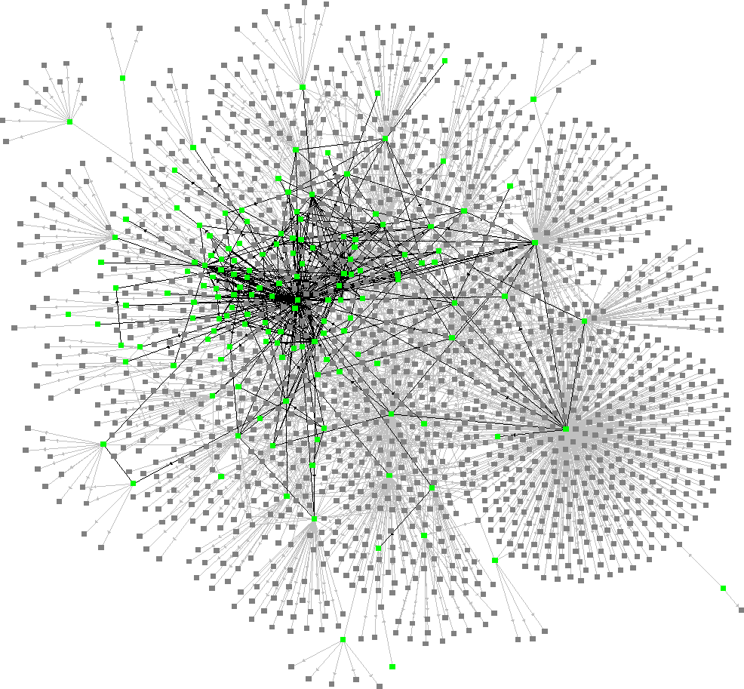
Data Structures 資料結構
Graphs – Part II
Image courtesy of www.escpeuropealumni.org
Department of Computer Science
National Tsing Hua University
Image courtesy of Ross Mayfield

Slide 2
Minimum-Cost Spanning Trees
For a weighted undirected graph, find a spanning tree with least cost of the sum of the edge weights.
Three greedy algorithms:
Kruskal’s algorithm
Prims’s algorithm
Sollin’s Algorithm
Spanning tree with cost 105
0
0
28
10
1
10
1
14
16
16
5
6
2
5
6
2
24
18
24
18
25
12
25
12
4
3
4
3
22

Slide 3
Kruskal’s Algorithm
Idea: Add edges with minimum edge weight to tree one at a time.
Step 1: Find an edge with minimum cost.
Step 2: If it creates a cycle, discard the edge.
Step 3: Repeat step 1 and 2 until we find n-1 edges.
找min -> 連起來 -> 有cycle -> discard -> 直到找到(n-1)個edge

Slide 4
Running Example
Refer to textbook for detailed steps!
0
0
28
10
1
10
1
14
16
14
16
5
6
2
5
6
2
24
25
18
12
25
12
4
3
4
3
22
22
Connected graph
Spanning tree with cost 99

Slide 5
Kruskal’s Algorithm
Kruskal’s algorithm T = ψ While((T contains less than n-1 edges)&&(E is not empty)){ choose an edge (v,w) from E of lowest cost; delete (v,w) from E if((v,w) does not create a cycle) add (v,w) to T; else discard (v,w) } If(T contains less than n-1 edges) cout << “there is no spanning tree!” <<endl;
Step 3 & 4: use min heap to store edge cost.
Step 5: use set representation to group all vertices in the same connected component into a set. (see appendix)
For an edge (v,w) to be added, if vertices are in the same set, discard the edge, else merge two sets.

Slide 6
Running Example
Disjoint set
0
0
1
2
3
4
5
6
10
1
5
6
2
4
3
Spanning tree with cost 99

Slide 7
Running Example
Disjoint set
0
0
1
2
3
4
6
10
1
5
5
6
2
12
4
3
Spanning tree with cost 99

Slide 8
Running Example
Disjoint set
0
0
1
2
4
6
10
1
14
5
3
5
6
2
12
4
3
Spanning tree with cost 99

Slide 9
Running Example
Disjoint set
0
0
2
4
6
10
1
14
16
5
3
1
5
6
2
12
4
3
Spanning tree with cost 99

Slide 10
Running Example
Disjoint set
0
0
2
4
10
1
14
16
5
3
6
5
6
2
1
12
4
3
22
Spanning tree with cost 99

Slide 11
Running Example
Disjoint set
0
0
2
10
1
14
16
5
3
6
5
6
2
4
1
25
12
4
3
22
Spanning tree with cost 99

Slide 12
Running Example
Disjoint set
0
2
10
1
14
16
0
3
6
5
6
2
5
4
1
25
12
4
3
22
Spanning tree with cost 99

Slide 13
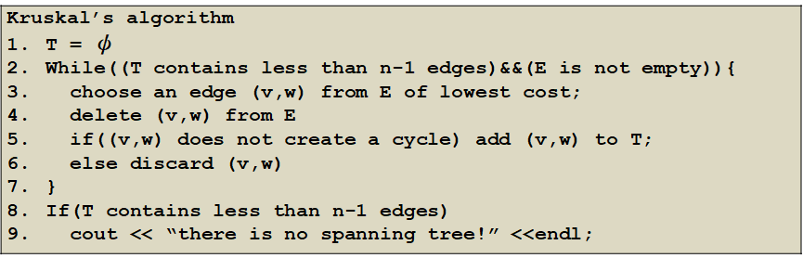
Time Complexity
Min heap:
Step 3&4 : O(log e)
Set:
Step 5: O(log e) -> see appendix
At most execute e-1 rounds:
(e-1)∙(log e + log e) = O(e log e)

Slide 14
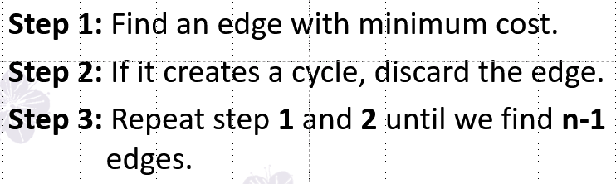
Kruskal’s Algorithm
Proof:
(a) Kruskal’s method results in a spanning tree whenever a spanning tree exists
(b) The generated spanning tree is of least cost
《Theorem 6.1》
Let G be any undirected connected graph.
Kruskal’s algorithm generates a minimum-cost spanning tree.

Slide 15
Kruskal’s Algorithm
Proof (a): it finds a spanning tree whenever a spanning tree exists
Only delete those edges that form a cycle.
Delete a cycle doesn’t affect the connectivity of the graph.
Always result in a connected graph with n-1 edges, therefore create a spanning tree.

Slide 16
Kruskal’s Algorithm
Proof (b): The generated spanning tree is of least cost
Let U be another minimum-cost spanning tree.
If T = U, then T is a minimum-cost spanning tree.
If T ≠ U, Let k, k > 0, be the number of edges in T not in U.
We shall see that there exists a way to transform U to T in k steps such that cost of U is not changed.

Slide 17
Kruskal’s Algorithm
Transform U to T:
(1) Let e be the least-cost edge in T that is not in U.
(2) When e is added to U, a unique cycle C is created.
(3) Let f be any edge on C that is not in T. (This edge must exists as T contains no cycle).
Now U = U+{e}-{f} is a spanning tree.
We need to proof that cost(e) = cost(f).
e
f
T
U

Slide 18
Kruskal’s Algorithm
Case i : cost(e) < cost(f)
cost (U+{e}-{f}) < cost(U) => Impossible!
Because U is a minimum cost spanning tree.
Case ii : cost(e) > cost(f)
f should be considered earlier than e in Kruskal’s algo.
f is not in T means f together with edges in T whose costs are less than or equal to f form the cycle C.
Those edges are also in U (because as mentioned earlier, e is the least-cost-edge which is in T but not in U), hence U (which contains f) must also contain a cycle. Contradiction!
Therefore cost(e)=cost(f).
e
f

Slide 19
Prim’s algorithm
Idea: Add edges with minimum edge weight to tree one at a time. At all times during the algorithm, the set of selected edges form a tree.
Step 1: Start with a tree T contains a single arbitrary vertex.
Step 2: Among all edges, add a least cost edge (u,v) to T such that T U (u,v) is still a tree.
Step 3: Repeat step 2 until T contains n-1 edges.

Slide 20
Running Example
Refer to textbook for detailed steps!
0
0
28
10
1
10
1
14
16
14
16
5
6
2
5
6
2
24
25
18
12
25
12
4
3
4
3
22
22
Connected graph
Spanning tree with cost 99

Slide 21
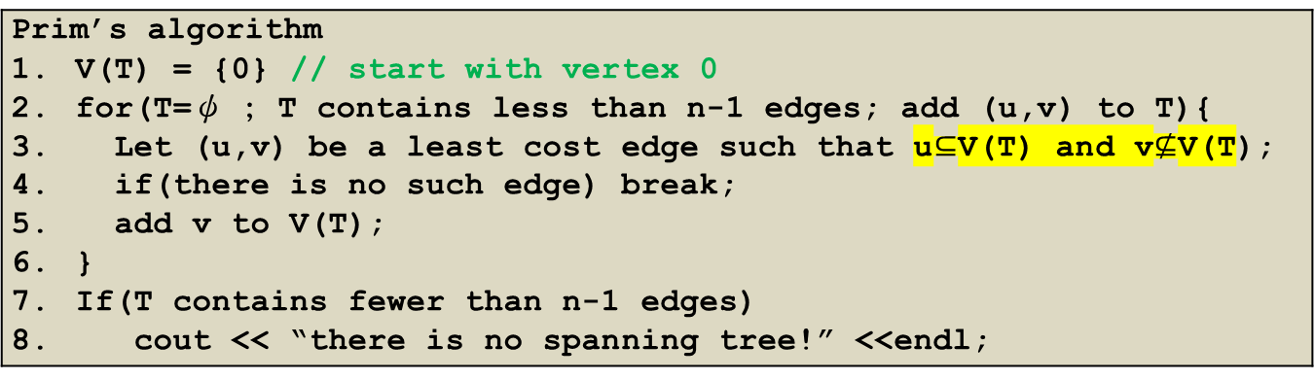
Prim’s Algorithm
Prim’s algorithm V(T) = {0} // start with vertex 0 for(T=ψ ; T contains less than n-1 edges; add (u,v) to T){ Let (u,v) be a least cost edge such that u$⊆$V(T) and v$⊈$V(T); if(there is no such edge) break; add v to V(T); } If(T contains fewer than n-1 edges) cout << “there is no spanning tree!” <<endl;
Step 3: use a near-to-tree data structure
Create an array to record the nearest distance of vertices to T.
Only vertices not in V(T) and adjacent to T are recorded.

Slide 22
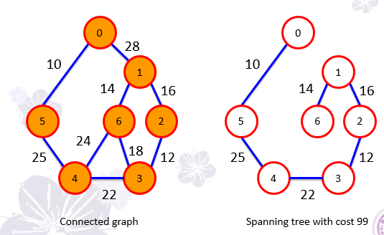
Running Example
near-to-tree | 0 | 1 | 2 | 3 | 4 | 5 | 6
V(T)={0}
* 28 ∞ ∞ ∞ 10 ∞
V(T)={0,5}
* 28 ∞ ∞ 25 * ∞
V(T)={0,5,4}
* 28 ∞ 22 * * 24
V(T)={0,5,4,3}
* 28 12 * * * 18
V(T)={0,5,4,3,2}
* 16 * * * * 18
V(T)={0,5,4,3,2,1}
* * * * * * 14
V(T)={0,5,4,3,2,1,6}

Slide 23
Time Complexity
Near-to-tree
Step 3 : O(n)
At most execute n rounds: O(n²)

Slide 24
Prim’s Algorithm: Correctness
See appendix

Slide 25
Sollin’s Algorithm
Idea: Select several edges at each stage.
Step 1: Start with a forest that has n spanning trees (each has one vertex).
Step 2: Select one minimum cost edge for each tree. This edge has exactly one vertex in the tree.
Step 3: Delete multiple copies of selected edges and if two edges with the same cost connecting two trees, keep only one of them.
Step 4: Repeat until we obtain only one tree.

Slide 26
Running Example
Refer to textbook for detailed steps!
0
0
28
10
1
10
1
14
16
14
16
5
6
2
5
6
2
24
25
18
12
25
12
4
3
4
3
22
22
Connected graph
Spanning tree with cost 99

Slide 27
Single Source Shortest Paths
Given a digraph with nonnegative edge costs, we want to compute the shortest path from a source vertex to all other vertices.
Single source/all destinations problem.
45
Paths from 0 to 1:
50
10
0
1
2
0->1 : 50
35
0->2->4->1 : 95
15
10
20
20
30
…
0->3->4->1 : 45
3
4
5
15
3

Slide 28
Dijkstra’s Algorithm “DIKE-stra” ([ˈdaɪk.stɹə])
Similar to Prim’s algorithm
Use a set S to store the vertices whose shortest path have been found
An array dist is used to store the shortest distances from source V to all vertices so far
An array π is used to store the vertex’s predecessor
When a new vertex w is visited, update dist as:
dist[w] = min(dist[u]+length(<u,w>),dist[w]) u is the previously visited vertex which is adjacent to w

Slide 29
Dijkstra’s Algorithm
Initialization: for i ϵ V, set dist[i]=length[v][i], dist[v]=0, π[i]=NULL
Steps:
Choose vertex u such that i) dist[u] is minimum and ii) vertex u is not in the S; Add u to S
Pick a vertex w not in the S, if dist[u]+length[u][w]< dist[w], then update:
dist[w] = dist[u]+length[u][w]
π[w] = u
Repeat the above steps n-1 times.

Slide 30
Running Example
vertex | π
0
1
2
3
4
5
45
NULL
50
10
NULL
0
0
1
2
4
0
15
35
NULL
10
20
20
30
NULL
0
3
NULL
3
4
5
15
3
NULL
S | 0 | 1 | 2 | 3 | 4 | 5
{0}
0 50 45 10 ∞ ∞
{0, 3}
0 50 45 10 25 ∞
{0, 3, 4}
0 45 45 10 25 ∞
{0, 3, 4, 1}
0 45 45 10 25 ∞
{0, 3, 4, 1, 2}
0 45 45 10 25 ∞

Slide 31
Dijkstra - How to Find the Path
Retrieve the path from the source vertex to any vertex w with the help of array π
Lookup w’s predecessor with π[w] (suppose vertex u), and u’s predecessor π[u] and so on, until we reach the source vertex.

Slide 32
Dijkstra - Finding the Path
vertex | π
0 | NULL
1 | 4
2 | 0
3 | 0
4 | 3
5 | NULL
Suppose we want to find the shortest path from 0 to 1
π[4]=3
π[3]=0
π[1]=4
0
10
3
15
4
20
1

Slide 33
Dijkstra’s Algorithm
void MatrixWDigraph::Dijkstra(const int n, const int v) { // dist[j], 0 ≤ j < n, stores the shortest path from v to j // length[i][j] stores length of edge <i, j> for(int i=0; i<n; i++){ s[i]=false; dist[i]=length[v][i]; π[i]=NULL;} s[v] = true; dist[v] = 0; // find n − 1 paths starting from v for(int i=0; i<n−1 ;i++){ // Choose a vertex u, such that dist[u] // is minimum and s[u] = false int u = Choose(n); s[u] = true; for(int w=0; w<n; w++){ if(!s[w] && dist[u] + length[u][w] < dist[w]){ dist[w] = dist[u] + length[u][w]; π[w]=u; } // end of for (i = 0; ...) }
O(n)
O(n)
O(n)
Time complexity: O(n²)

Slide 34
For Dijkstra algorithm, we assumed there is no edge with negative weight
What if such edges exist?

Slide 35
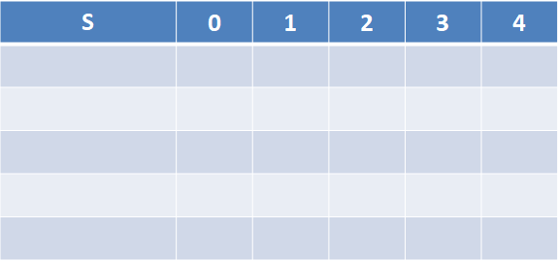
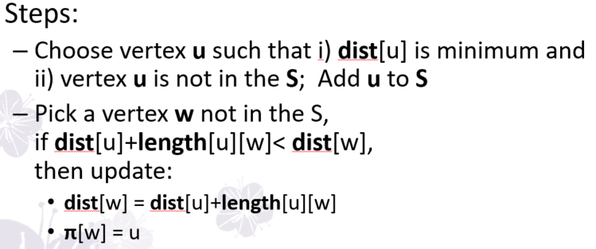
Running Example With Negative Edge
5
5
Why not update dist[1] with this edge?
Because vertex 1 is already in the set S.
1
2
1
2
6
-2
-2
6
0
8
0
8
7
7
-3
-4
-3
-4
7
7
3
4
3
4
9
9
vertex | π
0
1
2
3
4
NULL
NULL
{0}
0
0
6
∞
7
∞
3
NULL
1
4
{0, 1}
0
6
11
7
2
NULL
0
{0, 1, 4}
0
6
9
7
2
NULL
1
{0, 1, 4, 3}
0
6
4
7
2
{0, 1, 4, 3, 2}
0
6
4
7
2

Slide 36
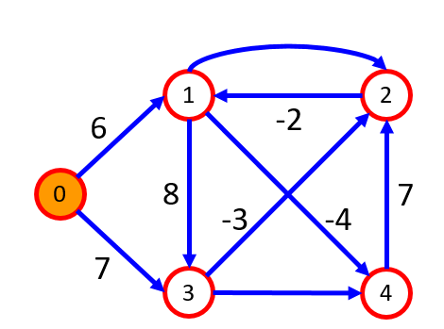
Dijkstra Went Wrong
Dijkstra finds shortest path from 0 to 4 as:
0
6
1
-4
4
vertex | π
0 | NULL
1 | 0
2 | 3
3 | 0
4 | 1
The correct shortest path from 0 to 4 should be:
0
7
3
-3
2
-2
1
-4
4
Dijkstra can’t handle graphs with negative edges

Slide 37
Bellman-Ford Algorithm
Works when edge weights may be negative
An array dist is used to store the shortest distances from source to all vertices so far
An array π is used to store the vertex’s predecessor
Relaxes all edges at most │V│-1 times
Ability to detect negative cycles
update dist[] using the equation:
dist[w] = min(dist[u]+length(<u,w>),dist[w]) u is the vertex adjacent to w
Notes:
如果做完 |V|-1次後，還能再修正最短路徑，那就是有negative cycle

Slide 38
Bellman-Ford Algorithm
Initialize: for i ϵ V, set dist[i]=∞, π[i]=NULL
For source v, dist[v]=0
Step:
For each edge <u,w> ϵ E, if dist[u] + length[u][w] < dist[w], then update
dist[w] = dist[u]+length[u][w]
π[w] = u
Repeat the above step |V|-1 times
Check whether the graph has a negative cycle

Slide 39
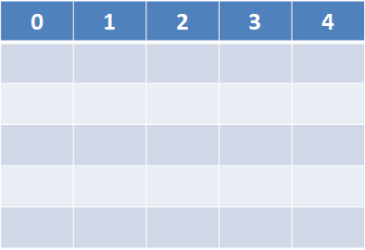
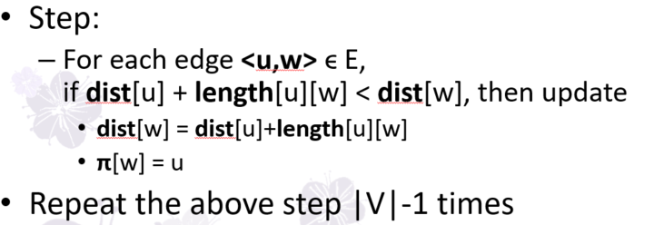
Running Example
5
i=2
vertex | π
0
1
2
3
4
i=4
i=3
i=1
1
2
6
-2
NULL
2
NULL
0
0
8
7
3
-3
-4
NULL
0
NULL
7
1
3
4
NULL
9
0
∞
∞
∞
∞
0
6
∞
7
∞
0
6
4
7
2
0
2
4
7
2
0
2
4
7
-2

Slide 40
Bellman-Ford - How to Find the Path
After the algorithm, we can find the shortest path from the source vertex to a vertex w with the array π
We use π[w] to find vertex w’s predecessor (suppose vertex u) and u’s predecessor and so on, until the source vertex is reached

Slide 41
Bellman-Ford - Find the Path (Similar to Dijkstra)
vertex | π
0 | NULL
1 | 2
2 | 3
3 | 0
4 | 1
Suppose we want to find the shortest path from 0 to 4
π[2]=3
π[4]=1
π[1]=2
π[1]=2
0
7
3
-3
2
-2
1
-4
4

Slide 42
Bellman-Ford Algorithm
bool MatrixWDigraph::Bellman_Ford (const int n, const int v) { // dist[j], 0 ≤ j < n, stores the shortest path from v to j // length[i][j] stores length of edge <i, j> // π [i] stores the predecessor of i for(int i=0; i<n; i++){ π[i]=NULL; dist[i]= ;}// initialize dist[v] = 0; // find n − 1 paths starting from v for(int i=1; i<=n−1 ;i++){ for each edge <u,w> ϵ E if(dist[u] + length[u][w] < dist[w]){ dist[w] = dist[u] + length[u][w]; π[w]=u; } } // end of for (i = 1; …) for each edge <u,w> ϵ E if(dist[u] + length[u][w] < dist[w]) return false; // have a negative cycle return true; }
∞
O(n)
O(│E│)
O(│E│)
Time complexity: O(n│E│)

Slide 43
All-Pairs Shortest Paths
One approach: Applying single source shortest path to each of n vertices
Another approach: Floyd-Warshall’s algorithm
We number the vertices from 0 to n-1, and maintain an array A
A⁻¹[i][j]: is just the length[i][j]
A^{n-1}[i][j]: the length of the shortest i-to-j path in G
A^{k}[i][j]: the length of the shortest path from i to j going through no intermediate vertex of index greater than k
A^{k}[i][j] = min{A^{k-1}[i][j], A^{k-1}[i][k]+ A^{k-1} [k][j] }, k ≥ 0

Slide 44
Floyd-Warshall’s Algorithm
There are only two possible paths for A^{k}[i][j]!
The path dose not pass vertex k.
The path dose pass vertex k.
A^{k}[i][j] = min{ A^{k-1}[i][j], A^{k-1}[i][k]+ A^{k-1} [k][j] }, k ≥ 0
K-1
0
…
i
j
K-1
k
K-1
0
…
0
…

Slide 45
Floyd-Warshall’s Algorithm
Array A stores the shortest distance between vertex i and j in V
Array p stores the vertices in the path from vertex i to j
Initialize: Set A⁻¹[i][j] = length[i][j], p[i][j]=-1
For k=0 to n-1, if A^{k-1}[i][k]+ A^{k-1} [k][j] < A^{k-1}[i][j], update A^{k}[i][j] = A^{k-1}[i][k]+ A^{k-1} [k][j], p[i][j] = k
Finally A^{n-1}[i][j] is the shortest distance from vertex i to j

Slide 46
Running Example
A⁻¹ | 0 | 1 | 2
0 | 0 | 4 | 11
1 | 6 | 0 | 2
2 | 3 | ∞ | 0
6
0
1
4
11
2
p | 0 | 1 | 2
0 | -1 | -1 | -1
1 | -1 | -1 | -1
2 | -1 | -1 | -1
3
2
A⁰[2][1] = min(A⁻¹[2][1], A⁻¹[2][0]+A⁻¹[0][1])
A⁰[2][1] = min(∞, 3+4) = 7
A⁰[1][2] = min(A⁻¹[1][2], A⁻¹[1][0]+A⁻¹[0][2])
A⁰[1][2] = min(2, 6+11) = 2

Slide 47
Running Example
A⁰ | 0 | 1 | 2
0 | 0 | 4 | 11
1 | 6 | 0 | 2
2 | 3 | 7 | 0
6
0
1
4
11
2
p | 0 | 1 | 2
0 | -1 | -1 | -1
1 | -1 | -1 | -1
2 | -1 | 0 | -1
3
2
A¹[2][0] = min(A⁰[2][0], A⁰[2][1]+A⁰[1][0])
A¹[2][0] = min(3, 7+6) = 3
A¹[0][2] = min(A⁰[0][2], A⁰[0][1]+A⁰[1][2])
A¹[0][2] = min(11, 4+2) = 6

Slide 48
Running Example
A¹ | 0 | 1 | 2
0 | 0 | 4 | 6
1 | 6 | 0 | 2
2 | 3 | 7 | 0
6
0
1
4
11
p | 0 | 1 | 2
0 | -1 | -1 | 1
1 | -1 | -1 | -1
2 | -1 | 0 | -1
3
2
2
A²[0][1] = min(A¹[0][1], A¹[0][2]+A¹[2][1])
A²[0][1] = min(4, 6+7) = 4
A²[1][0] = min(A¹[1][0], A¹[1][2]+A¹[2][0])
A²[1][0] = min(6, 2+3) = 5

Slide 49
Running Example
6
0
1
A² | 0 | 1 | 2
0 | 0 | 4 | 6
1 | 5 | 0 | 2
2 | 3 | 7 | 0
4
11
3
2
2
p | 0 | 1 | 2
0 | -1 | -1 | 1
1 | 2 | -1 | -1
2 | -1 | 0 | -1

Slide 50
Floyd-Warshall - How to Find the Path
With the help of array p
If p[i][j] = -1, no vertex is needed to go through for the shortest path from i to j
Otherwise, lookup p[i][j] to find vertex required to go thorugh (suppose vertex k), and then find the shortest path from i to k and from k to j

Slide 51
Floyd-Warshall find the path
Suppose we want to find the shortest path from 0 to 2
p | 0 | 1 | 2
0 | -1 | -1 | 1
1 | 2 | -1 | -1
2 | -1 | 0 | -1
p[0][2]=1
p[0][1]=-1
p[1][2]=-1
0
4
1
2
2

Slide 52
Floyd-Warshall’s Algorithm
void MatrixWDigraph::AllLengths(const int n) {// length[n][n] stores edge length between // adjacent vertices // a[i][j] stores the shortest path from i to j for (int i = 0; i<n; i++) for (int j = 0; j<n; j++) a[i][j]= length[i][j]; // path with top vertex index k for (int k= 0; k<n; k++) // all other possible vertices for (int i= 0; i<n; i++) for (int j= 0; j<n; j++) if((a[i][k]+a[k][j])<a[i][j]){ a[i][j] = a[i][k] + a[k][j]; p[i][j] = k; } }
O(n)
O(n)
O(n)
O(n)
O(n)
Time complexity: O(n³)

Slide 53
Transitive Closure
0
1
2
3
A⁺ | 0 | 1 | 2 | 3
0 | 0 | 1 | 1 | 1
1 | 0 | 1 | 1 | 1
2 | 0 | 1 | 1 | 1
3 | 0 | 0 | 0 | 0
A* | 0 | 1 | 2 | 3
0 | 1 | 1 | 1 | 1
1 | 0 | 1 | 1 | 1
2 | 0 | 1 | 1 | 1
3 | 0 | 0 | 0 | 1
Transitive closure matrix
Reflexive transitive closure matrix

Slide 54
Transitive Closure
The transitive closure matrix A⁺:
A⁺ is a matrix such that A⁺[i][j] = 1 if there is a path of length > 0 from i to j in the graph; otherwise, A⁺[i][j] = 0.
The reflexive transitive closure matrix A*:
A* is a matrix such that A*[i][j] = 1 if there is a path of length >= 0 from i to j in the graph; otherwise, A*[i][j] = 0.
Use Floyd-Warshall’s algorithm!
A^{k}[i][j] = A^{k-1}[i][j] || ( A^{k-1}[i][k] && A^{k-1} [k][j] );

Slide 55
Activity-on-Vertex (AOV) Networks
A digraph G where the vertices represent tasks or activities and the edges represent precedence relations between tasks.
C₁
Predecessor :
Vertex i is a predecessor of vertex j, iff there is a directed path from vertex i to vertex j.
C₀
C₃
C₂

Slide 56
AOV Network
Topological order:
A linear ordering of the vertices of a graph such that, for any two vertices i and j, if i is a predecessor of j in the network, then i precedes j in the linear ordering.
C₁
C0 -> C1 -> C2 -> C3 (O)
C₀
C₃
C0 -> C2 -> C1 -> C3 (O)
C₂
C0 -> C2 -> C3 -> C1 (X)

Slide 57
Application
Course No. | Course | Prerequisites
C1 | Programming I | None
C2 | Discrete Mathematics | None
C3 | Data Structures | C1, C2
C4 | Calculus I | None
C5 | Calculus II | C4
C6 | Linear Algebra | C5
C7 | Analysis of Algorithms | C3, C6
C8 | Assembly Language | C3
C9 | Operating Systems | C7, C8
C10 | Programming Languages | C7
C11 | Compiler Design | C10
C12 | Artificial Intelligence | C7
C13 | Computational Theory | C7
C14 | Parallel Algorithms | C13
C15 | Numerical Analysis | C5

Slide 58
AOV Network of Courses
Use topological ordering to generate a linear order list. This list represents one possible way to take all the courses

Slide 59
Topological Ordering
Iteratively pick a vertex v that has no predecessors.
Use an additional field “count” to record the “in-degree” value of each vertex.
adjLists
0
[0]
1
2
3
0
1
1
[1]
4
0
0
2
4
1
[2]
4
5
0
1
[3]
5
4
0
3
5
3
[4]
NULL
2
[5]
NULL

Slide 60
Running Example
adjLists
0
[0]
1
2
3
0
1
1
[1]
4
0
0
2
4
1
[2]
4
5
0
1
[3]
5
4
0
3
5
3
[4]
NULL
2
[5]
NULL
Ordered list:

Slide 61
Running Example
adjLists
0
[0]
1
2
3
0
1
0
[1]
4
0
2
4
0
[2]
4
5
0
0
[3]
5
4
0
3
5
3
[4]
NULL
2
[5]
NULL
Ordered list:
0

Slide 62
Running Example
adjLists
0
[0]
1
2
3
0
1
0
[1]
4
0
2
4
0
[2]
4
5
0
0
[3]
5
4
0
5
2
[4]
NULL
1
[5]
NULL
Ordered list:
0
3

Slide 63
Running Example
adjLists
0
[0]
1
2
3
0
1
0
[1]
4
0
4
0
[2]
4
5
0
0
[3]
5
4
0
5
1
[4]
NULL
0
[5]
NULL
Ordered list:
0
3
2

Slide 64
Running Example
adjLists
0
[0]
1
2
3
0
1
0
[1]
4
0
4
0
[2]
4
5
0
0
[3]
5
4
0
1
[4]
NULL
0
[5]
NULL
Ordered list:
0
3
2
5

Slide 65
Running Example
adjLists
0
[0]
1
2
3
0
0
[1]
4
0
4
0
[2]
4
5
0
0
[3]
5
4
0
0
[4]
NULL
0
[5]
NULL
Ordered list:
0
3
2
5
1

Slide 66
Running Example
adjLists
0
[0]
1
2
3
0
0
[1]
4
0
0
[2]
4
5
0
0
[3]
5
4
0
0
[4]
NULL
0
[5]
NULL
Ordered list:
0
3
2
5
1
4

Slide 67

Self-Study Topics
Single source shortest path
Bellman-Ford’s algorithm (Digraph with negative edge costs)
Activity-on-Edge (AOE) Networks
Critical path analysis

Slide 68
Appendix – recap of set union

Slide 69
DS: Tree Representation
Link elements of a subset to form a tree
Link children to root
Link root to set name
Set name
S₁
0
1
4
S₂
2
3
5
S₃
S₁
S₂
S₃

Slide 70
DS: Tree Representation
Use an array to store the tree
Identify the set by the root of the tree
T[0]
-1
Set name
T[1]
-1
S₁
0
1
4
T[2]
0
S₂
2
3
5
T[3]
0
S₃
S₁
S₂
S₃
T[4]
-1
T[5]
4

Slide 71
DS Operation: Union(S_{i}, S_{j})
Set the parent field of one of the root to the other root
S₁=Union(S₁, S₃)
Time complexity : O(1)
T[0]
-1
T[1]
-1
T[2]
0
0
4
0
T[3]
0
2
3
5
2
3
4
T[4]
-1
0
S1
S3
T[5]
5
4

Slide 72
DS Operation: Find(x)
Following the index starting at x and tracing the tree structure until reaching a node with parent value = -1
Use the root to identify the set name
T[0]
-1
Set name
T[1]
-1
S₁
0
1
4
T[2]
0
S₂
2
3
5
T[3]
0
S₃
S₁
S₂
S₃
T[4]
-1
T[5]
4
Find(3)
= S₁

Slide 73
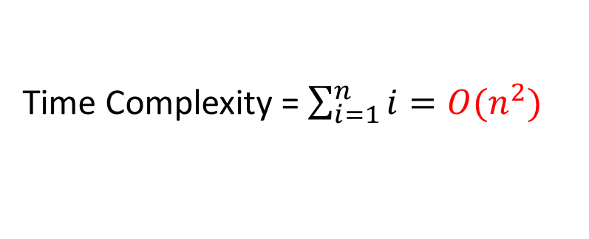
DS Time Complexity
S = { 0, 1, 2, … , n-1 }
S₁ = { 0 }, S₂ = { 1 }, S₃ = { 2 }, … , S_{n} = { n-1 }
Perform a sequence Union
Union(S₂, S₁), Union(S₃, S₂), …, Union(S_{n}, S_{n-1})
n-1
Followed by a sequence of Find
Find(0), Find(1), …, Find(n-1)
2
1
Time Complexity = $\sum_{i=1}^{n}{i}=O(n^{2})$
0

Slide 74
Improved Union(S_{i}, S_{j})
Do not always merge two sets into the first set
Adopt a Weighting rule to union operation
S_{i} = S_{i} U S_{j}, if | S_{i} | >= | S_{j} |
S_{j} = S_{i} U S_{j}, if | S_{i} | < | S_{j} |
S = { 0, 1, 2, … , n }
S₁ = { 0 }, S₂ = { 1 }, S₃ = { 2 }, … , S_{n} = { n-1 }
Union ( 1, 2 )->Union ( 1, 3 )->Union ( 1, 4 )
0
1
2
3

Slide 75
Maximum Tree Height
Lemma 5.5
Let T be a tree with m nodes created by a sequence of weighting unions. The height of T is no greater than log₂m +1
Proof with Induction:
1) m=1 is true
2) Assume it is true for all trees with i nodes, i<=m-1

Slide 76
We’d like to show that it is also true for i=m
Let T be a tree with m nodes created by function WeightedUnion. Consider the last union operation performed on Union(k,j)
Let a be the number of nodes in tree j and (m-a) the number in k. Wlog, we may assume 1<=a<=m/2.
Then, the height of T is either 1) the same as that of k (m-a>a) or 2) is one more than that of j (m-a=a)
For case 1, height(T)<=floor(log₂(m-a))+1<=floor(log₂m)
For case 2, height(T)<=floor(log₂a)+2<=floor(log₂m/2)+2 <=floor(log₂m)+1

Slide 77
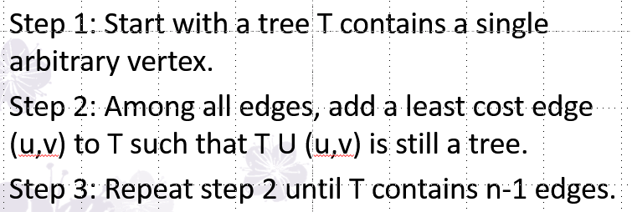
Prim’s Algorithm - Correctness
Prove with induction.
Hypothesis: After each iteration, the tree T is a subgraph of some minimum spanning tree M.
At iteration 1, this is trivially true because T is a single vertex.
Suppose that at iteration k, we have T which is a subgraph of M, and Prim’s Algorithm tells us to add the edge e.
We need to prove that T U {e} is also a subtree of some MST (not necessarily M).

Slide 78
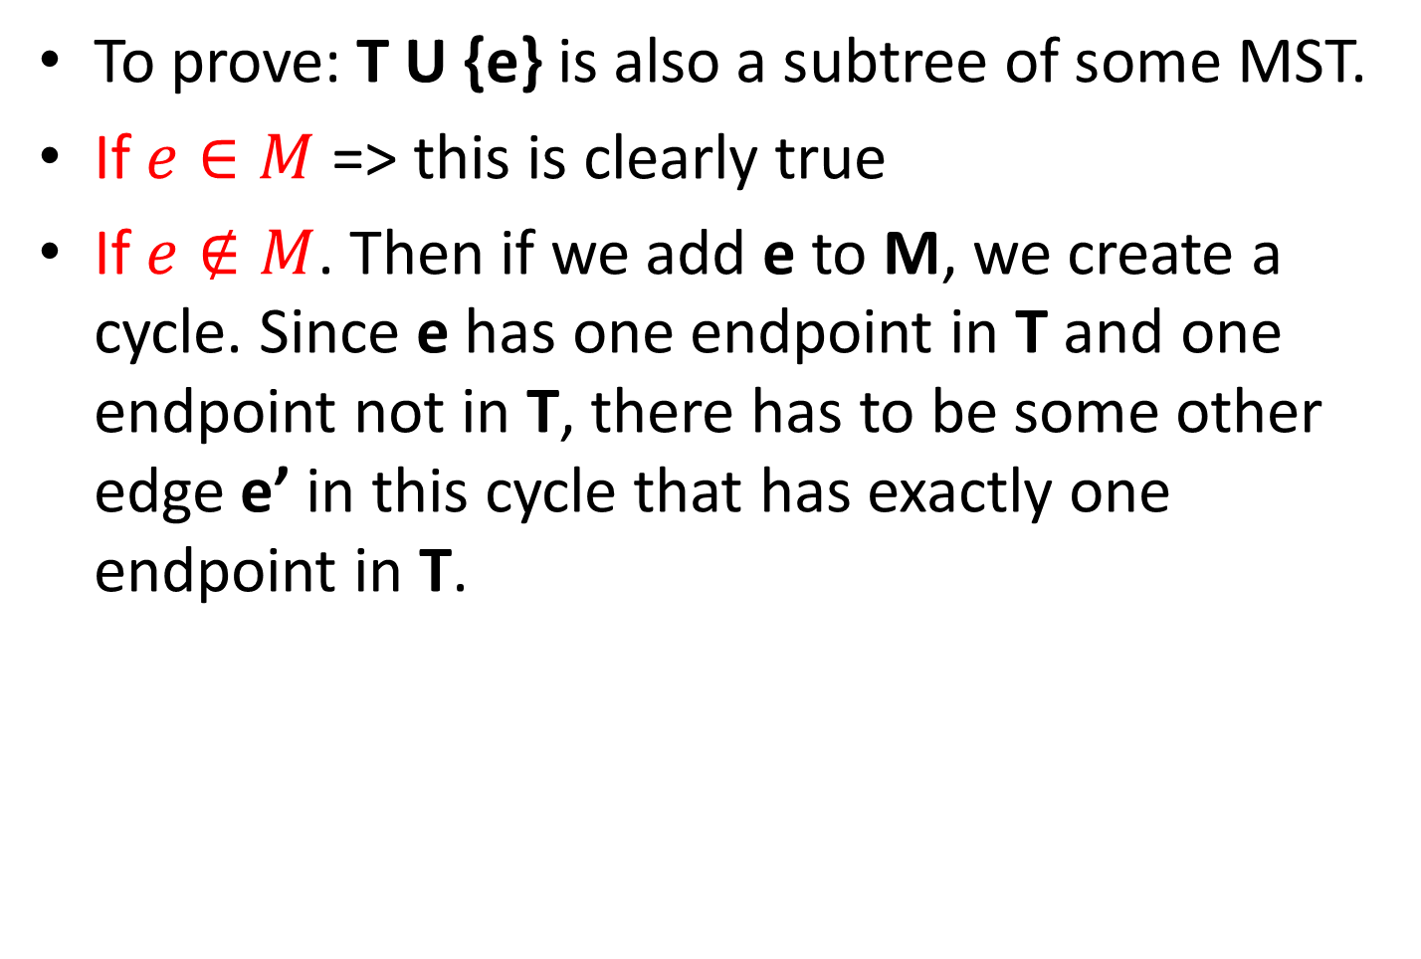
Prim’s Algorithm - Correctness
To prove: T U {e} is also a subtree of some MST.
If $e∈M$ => this is clearly true
If $e∉M$. Then if we add e to M, we create a cycle. Since e has one endpoint in T and one endpoint not in T, there has to be some other edge e’ in this cycle that has exactly one endpoint in T.

Slide 79
Prim’s Algorithm - Correctness
Therefore, Prim’s Algorithm could have added e’ but instead chose to add e, which means that w(e’)>=w(e). So if we add e to M and remove e’, we create a new tree M’ whose total weight is at most the weight of M, and which contains T U {E}. This maintains the induction, so proves the theorem.
(In fact, w(e’)=w(e) must hold. Otherwise M’ would have weight less than M, contradicting the assumption that M is an MST.
Bellman-Ford how to find the path

